Slide 1
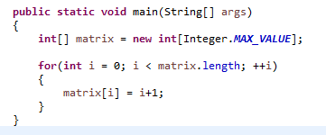
The OutOfMemoryError in Java
This error indicates that a Java application attempts to allocate an array, whose size is larger than the heap size.

Slide 2
The OutOfMemoryError in Java
Below are different causes that can throw an OutOfMemoryError in Java
java.lang.OutOfMemoryError: Java heap space.
java.lang.OutOfMemoryError: PermGen space.
This error indicates that the permanent generation is full. In Java, the permanent generation is the memory space where class and method objects are stored.
java.lang.OutOfMemoryError: Requested array size exceeds VM limit. This error indicates that a Java application attempts to allocate an array, whose size is larger than the heap size.
java.lang.OutOfMemoryError: <reason> <stack trace> (Native method).
This error indicates that the allocation failure was detected in a JNI or native method instead of the JVM code.
java.lang.OutOfMemoryError: request <size> bytes for <reason>. Out of swap space?
This error indicates that an allocation from the native heap space has failed and also, the heap space is close to exhaustion. Moreover, the message of the error indicates the number of bytes that failed and the reason for the memory request.

